Slide 1


Gum Creek Gold Project
Investor Presentation March 2026
ASX: HRN

Slide 2

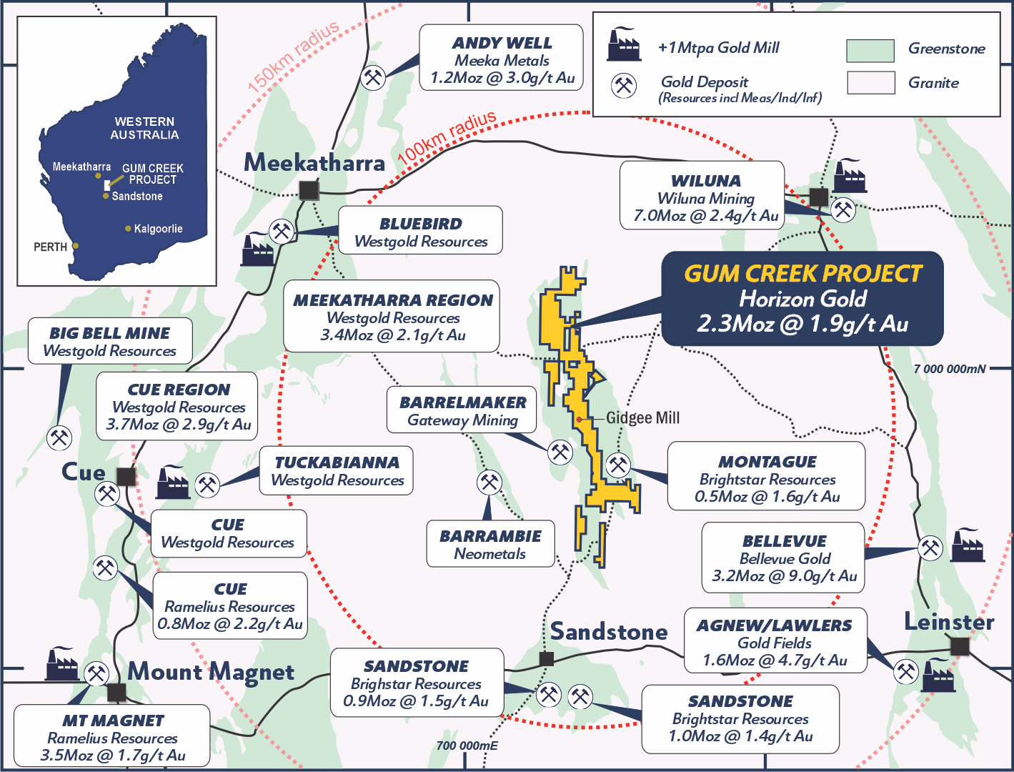
Investment Highlights
Gum Creek Gold Project
Large-scale, High-Grade Restart
2.3Moz @ 1.9g/t Au* (71% indicated)
Gidgee Shear zone (1.05Moz @ 2.17g/t Au*) (66% indicated) and Howards (245koz @ 1.11g/t Au*) (90% indicated
Feasibility Study due in 1HCY26
Shallow, free milling open pittable feed from the Gidgee Shear Zone and Howards mining areas
80km-long underexplored greenstone belt
Assays pending at Kingfisher – historic intersections including 15m @ 28.5g/t Au, 10m @ 8.9g/t Au**
Currently drilling Omega – historic intersections including 30m @ 21.1g/t Au, 13m @ 10.8g/t Au
Existing Mining Leases in a prolific WA gold district
Existing infrastructure on granted mining leases
Strategically located – 6 operating gold mills within 150km of the project
Source: * Refer to Horizon Gold Limited ASX Announcement titled “Gum Creek Project Resource Update" dated 4 November 2025.
**Refer to Horizon Gold Limited ASX announcement titled “Diamond drilling returns 15m @ 28.5g/t Au from Kingfisher" dated 12 December 2022.

Slide 3
Open Pit Mining @ 3.5g/t Au (1989-2002)
Underground Mining @
6.0g/t Au (2003-2005)
Source: Refer to Horizon Gold Prospectus dated 19th December 2016

Slide 4
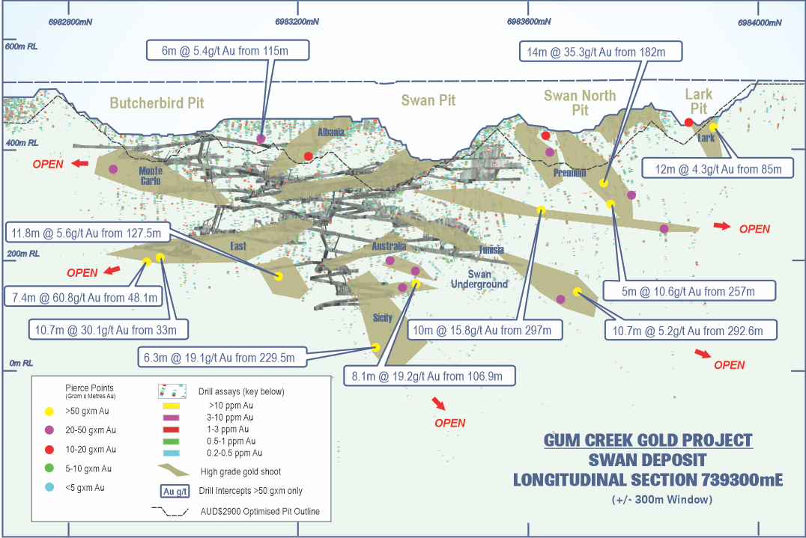
Swan Underground Potential
Largest free milling high-grade underground resource
Swan Underground MRE reported as 1.73Mt @ 4.19g/t Au for 233,700 ounces (57% Indicated)*
Moderate NE dipping and shallow SE dipping conjugate vein sets emanating from the broader north-south steeply dipping shear zone (Gidgee Shear)
Significant amount of unmined high-grade shoots near existing underground mining infrastructure
Historic underground intersections including**:
    7.4m @ 60.8g/t Au from 48m
    10.7m @ 30.1g/t Au from 33m
    8.1m @ 19.2g/t Au from 107m
    6.3m @ 19.1g/t Au from 229m
    10m @ 15.8g/t Au from 297m
    11.8m @ 5.6g/t Au from 127m
Long section of Swan deposit showing A$2,900 optimised pit shells (blue), >50GxM unmined intercepts, interpreted high-grade gold shoots and existing underground workings**
Source: * Refer to Horizon Gold Limited ASX Announcement titled “Gum Creek Project Resource Update" dated 4 November 2025 for further information.
** Refer to Horizon Gold Limited ASX announcement titled “Gum Creek Geological Review” dated 15 February 2021 & “Significant RC Drilling Results from Swift, Swan and Eagle Targets” dated 16 June 2021 for drilling intercept information.

Slide 5
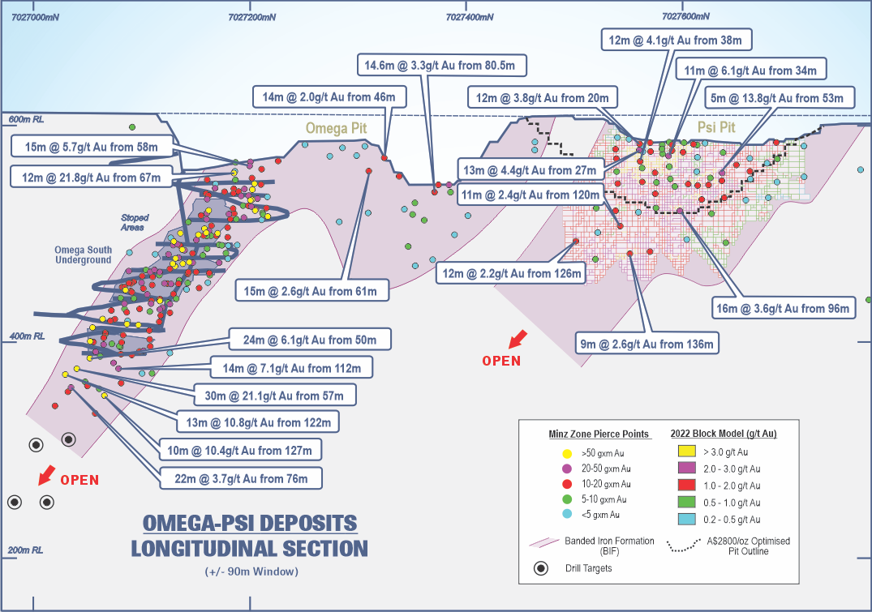
Omega Exploration Potential
High-grade exploration potential
High-Grade Production History: Omega Pit previously produced 44koz @ 5.4g/t Au, while the Omega Underground delivered 40koz @ 5.3g/t Au, demonstrating consistent high-grade mineralisation across previous mining phases
Drilling planned at Omega to follow up historical drilling intercepts not mined
  Omega down-plunge extensions including:
    30m @ 21.1g/t Au from 57m
    13m @ 10.8g/t Au from 122m
    24m @ 6.1g/t Au from 50m
    10m @ 10.4g/t Au from 127m
    14m @ 7.1g/t Au from 112m
    22m @ 3.7g/t Au from 76m
Source: Refer to Horizon Gold Limited ASX announcement titled “Gum Creek Geological Review” dated 15 February 2021 for drilling intercept information. Historical production data has been sourced from: Ross, D I and Smith, D W, 1998. Omega gold deposit, Gidgee, in Geology of Australian and Papua New Guinean Mineral Deposits (Eds: D A Berkman and D H Mackenzie), pp 119–122 (The Australasian Institute of Mining and Metallurgy: Melbourne).

Slide 6
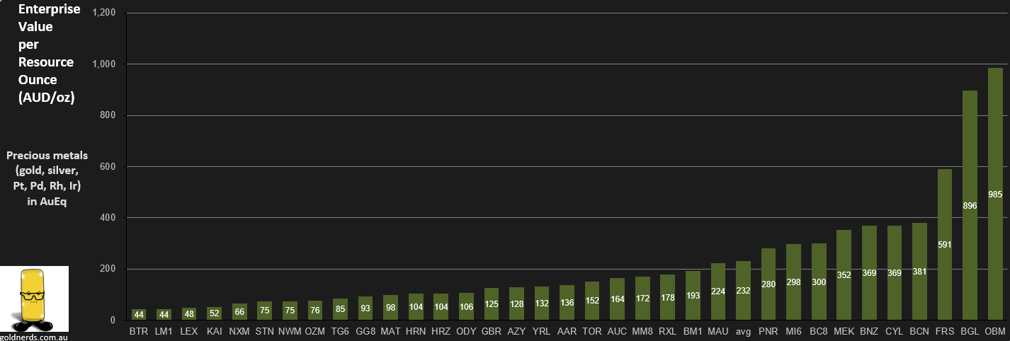
West Australian Gold Mining Juniors
EV/Resource Oz (A$/Oz)
2.2x

Slide 7





EXECUTIVE SUMMARY
High-quality gold asset in a tier-1 mining jurisdiction
Large-scale, High-Grade Asset with Low Mining Recommencement Risk
37.97Mt @ 1.89g/t Au for 2.30Moz (71% indicated) on granted mining leases across 26 deposits, 70% free-milling gold with > 90% recoveries
Two large mineralised systems including Gidgee Shear zone (1.05Moz @ 2.17g/t) and Howards (245koz @ 1.11g/t) underpinning base mill feed
Feasibility Study due in 1HCY26
Positive Scoping Study in 2024 confirmed a standalone 2.4Mtpa operation at Gum Creek
All key workstreams on track for H1-2026 Feasibility completion, focused on shallow, free milling open pittable feed from the Gidgee Shear Zone and Howards area
Material exploration upside targeting higher grade intersections
Significantly underexplored 80km-long project strike with low discovery cost, focused on open pittable and high-grade underground resources
Drilling underway at Kingfisher – stacked lodes plunging to the south, with better grades at depth including 15m @ 28.5g/t Au, 10m @ 8.9g/t Au
Omega – targeting depth extensions of historical intersections, including 30m @ 21.1g/t Au, 13m @ 10.8g/t Au, 10m @ 10.4g/t Au
Resources On Existing Mining Leases and Established Infrastructure Supports Rapid Restart
Planned central mill to be located at the historically permitted Gidgee site. Large resources located on existing mining leases provide streamlined pathway to production. Existing haul roads, ROM pad, camp and tailings infrastructure reduce development timelines and capex intensity
Located in a prolific WA gold district with nearby consolidation opportunities (Brightstar Resources, Aurumin, Gateway Resources, Neometals)
Experienced Board and Technical Team
Led by seasoned mining executives with deep exploration, development, and corporate experience
Notes:
It’s been a busy 12 months: nearly 2,000m of Geotechnical diamond drilling, just over 13,000m infill RC resource drilling (181 holes), 24 water bores for 2,700m, 2,200m sterilisation drilling and TSF test bores (50 holes), plus the 4,400m of recent RC resource expansion drilling (56 holes) – results pending and 3 deep diamond holes completed so far at KF (1,691m), currently drilling the 4th hole
Over the next 12 months we have some low grade waste stockpile drilling and heap leach drilling planned, plus another 19Km of resource drilling planned, plus a potential drill out of Kingfisher and Swift UG resources

Slide 8
CONTACT DETAILS
Scott Williamson
Managing Director & CEO
T: +61 8 6331 6092
E: info@horizongold.com.au
Unit 8 / 47 Havelock St.
West Perth, WA 6005
horizongold.com.au
ASX: HRN

Slide 9
GUM CREEK GOLD PROJECT RESOURCE ^{1,2}
Source: (1) Refer to Horizon Gold Limited ASX Announcement titled “Gum Creek Project Resource Update" dated 4 November 2025 for more information. (2) Figures are rounded.
* cut-off grades are 1.5g/t Au for Swan UG, Swift UG, Wilsons UG and Kingfisher UG.
** Wyooda includes the Kingston Town, Think Big and Manikato resources.

