Slide 1


Gum Creek Gold Project
AGM Presentation
ASX: HRN
20 November 2025

Slide 2

IMPORTANT NOTICE AND DISCLAIMER
No New Information or Data
This presentation contains references to exploration results and Resource estimates, all of which have been cross referenced to previous market announcements made by the Company. The Company confirms that it is not aware of any new information or data that materially affects the information included in the relevant market announcements and, in the case of estimates of Mineral Resources, that all material assumptions and technical parameters underpinning the estimates in the relevant market announcement continue to apply and have not materially changed.
This presentation contains references to forecast financial information extracted from the Company's announcement titled “Compelling Gum Creek Scoping Study “ dated 20 March 2024. The Company confirms that it is not aware of any new information or data that materially affects the information included in the original announcement, all material assumptions and technical parameters underpinning the forecast financial information derived from the Scoping Study and included in the original announcement continue to apply and have not materially changed.
Cautionary Statement
The mine production target and forecast financial information referred to in the Gum Creek Scoping Study includes Indicated Mineral Resources (approximately 76%) and Inferred Mineral Resources (approximately 24%). The Inferred material does not have a material effect on the technical and economic viability of the Gum Creek Gold Project. There is a low level of geological confidence associated with Inferred Mineral Resources and there is no certainty that further exploration work will result in the determination of Indicated Mineral Resources or that the production target itself will be realised.
Forward Looking Statements
This presentation may contain certain “forward-looking statements” which may not have been based solely on historical facts but rather may be based on the Company’s current expectations about future events and results. Where the Company expresses or implies an expectation or belief as to future events or results, such expectation or belief is expressed in good faith and believed to have a reasonable basis. However, forward looking statements are subject to risks, uncertainties, assumptions and other factors, which could cause actual results to differ materially from future results expressed, projected or implied by such forward-looking statements. Such risks include, but are not limited to metals price volatility, currency fluctuations, as well as political and operational risks and governmental regulation and judicial outcomes.
Competent Persons Statement
The information in this presentation that relates to exploration results and Mineral Resources is based on information compiled by Mr Leigh Ryan, who is a member of The Australasian Institute of Geoscientists. Mr Ryan is the Managing Director of Horizon Gold Limited and holds shares and options in the Company, Mr Ryan has sufficient experience, which is relevant to the style of mineralisation and type of deposit under consideration and to the activity which he is undertaking to qualify as a Competent Person as defined in the 2012 Edition of the "Australasian Code for Reporting of Exploration Results, Mineral Resources and Ore Reserves”. Mr Ryan consents to the inclusion in the presentation of the matters based on information provided in the form and context in which it appears.

Slide 3





EXECUTIVE SUMMARY
High-quality gold asset in a tier-1 mining jurisdiction
Large-scale, High-Grade Asset with Low Mining Recommencement Risk
37.97Mt @ 1.89g/t Au for 2.30Moz (71% indicated) on granted mining leases across 26 deposits, 70% free-milling gold with > 90% recoveries
Two large mineralised systems including Gidgee Shear zone (1.05Moz @ 2.17g/t) and Howards (245koz @ 1.11g/t) underpinning base mill feed
Feasibility Study due in 1HCY26
Positive Scoping Study confirmed standalone operation potential @ A$2,900/oz.
All key workstreams on track for H1-2026 Feasibility completion, focused on shallow, free milling open pittable feed from the Gidgee Shear Zone and Howards area
Material exploration upside targeting higher grade intersections
Significantly underexplored 80km-long project strike with low discovery cost, focused on open pittable and high-grade underground resources
Drilling underway at Kingfisher – stacked lodes plunging to the south, with better grades at depth including 15m @ 28.5g/t Au, 10m @ 8.9g/t Au
Omega – targeting depth extensions of historical intersections, including 30m @ 21.1g/t Au, 13m @ 10.8g/t Au, 10m @ 10.4g/t Au
Resources On Existing Mining Leases and Established Infrastructure Supports Rapid Restart
Planned central mill to be located at the historically permitted Gidgee site. Large resources located on existing mining leases provide streamlined pathway to production. Existing haul roads, ROM pad, camp and tailings infrastructure reduce development timelines and capex intensity
Located in a prolific WA gold district with nearby consolidation opportunities (Brightstar Resources, Aurumin, Gateway Resources, Neometals)
Experienced Board and Technical Team
Led by seasoned mining executives with deep exploration, development, and corporate experience
Notes:
It’s been a busy 12 months: nearly 2,000m of Geotechnical diamond drilling, just over 13,000m infill RC resource drilling (181 holes), 24 water bores for 2,700m, 2,200m sterilisation drilling and TSF test bores (50 holes), plus the 4,400m of recent RC resource expansion drilling (56 holes) – results pending and 3 deep diamond holes completed so far at KF (1,691m), currently drilling the 4th hole
Over the next 12 months we have some low grade waste stockpile drilling and heap leach drilling planned, plus another 19Km of resource drilling planned, plus a potential drill out of Kingfisher and Swift UG resources

Slide 4
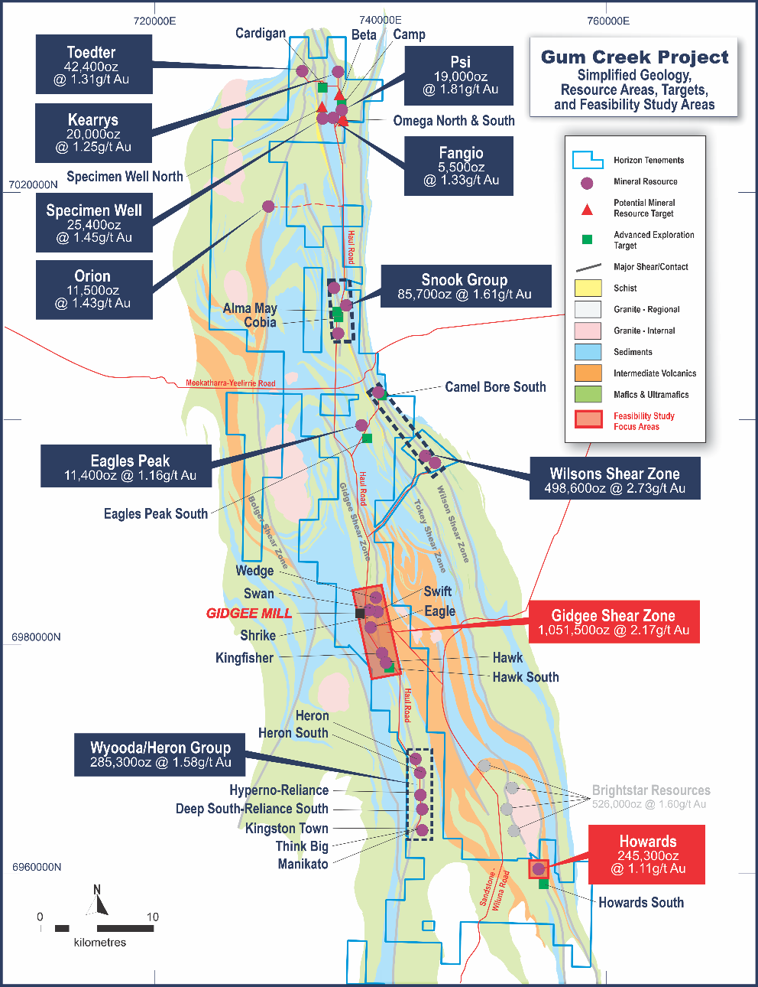
GUM CREEK GOLD PROJECT
Gum Creek Gold Project
Largest gold resource (2.30 Moz* – 71% Indicated) in the Sandstone District, with significant exploration upside and potential consolidation opportunities
Well-endowed gold region – the GCGP has historically produced more than 1.1 Moz** with last mining in 2005 when gold price was A$560/oz
Compelling standalone free milling gold development opportunity on granted mining leases, providing a streamlined permitting process
Feasibility Study (FS) progressing following very positive Scoping Study; FS is focused on the Gidgee Shear Zone and Howards resource areas (81% of free milling MRE ounces)
Planned central mill facility at established operating site, serviced with well maintained gravel roads, existing haul roads, tailings facility ROM pad, camp and other infrastructure
Ongoing exploration targeting higher grade feed and resource growth
Mineral Resource Estimate *
Resource | Tonnes | Grade | Contained
 | Mt | g/t Au | Moz Au
Indicated | 26.7 | 1.90 | 1.63
Inferred | 11.3 | 1.86 | 0.67
Total | 38.0 | 1.89 | 2.30
Source: * Refer to Horizon Gold Limited ASX Announcement titled “Gum Creek Project Resource Update" dated 4 November 2025.
** Refer to Horizon Gold Limited ASX Announcement titled “Horizon Gold Limited Prospectus” dated 19 December 2016.

Slide 5
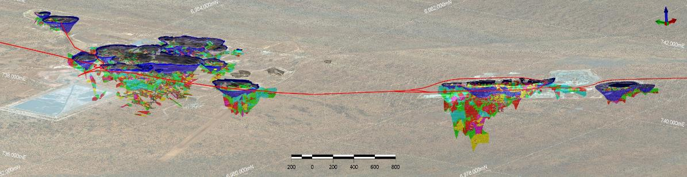

Gidgee Shear Zone
Main free milling ore source underpinning mine life and economics adjacent to Gidgee Mill
+7km long mineralised system hosting 1.05Moz @ 2.17g/t Au* (66% Indicated, 66% of free milling oz) adjacent to the Gidgee mill
Sub-parallel shears up to 60m wide; mineralisation open along strike and down plunge at all deposits
Potential to expand the open cut and underground gold resources (majority of drilling <100m)
Wedge
Swift
Proposed Plant Site
Kingfisher
Hawk
Swan
Eagle
3D view of Main Gidgee Mining Area looking down to the northeast showing A$2,900 optimised pit shells (blue), existing haul roads (red) and MRE block models (coloured by Au g/t)
Source: * Refer to Horizon Gold Limited ASX Announcement titled “Gum Creek Project Resource Update" dated 4 November 2025 for further information.

Slide 6
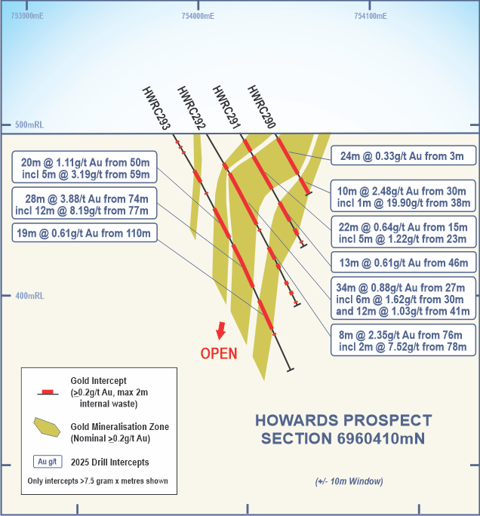
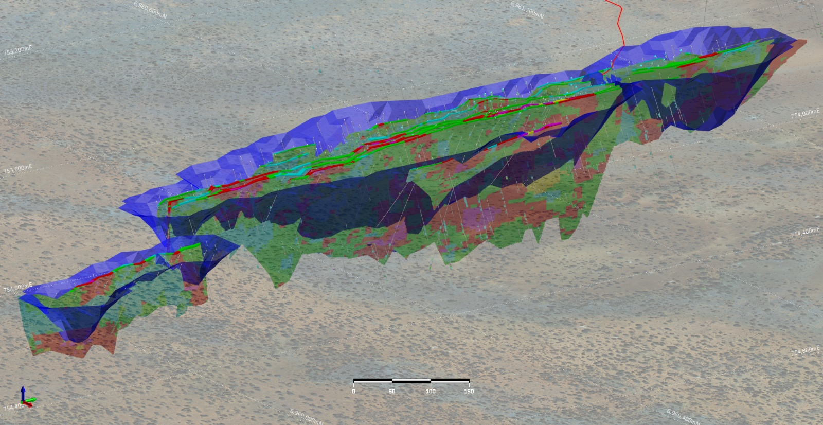

Howards Deposit
2nd bulk tonnage free milling deposit underpinning mine life and economics
2.5km long mineralised zone hosting 245koz @ 1.11g/t Au* (90% Indicated, 15% of free milling oz.)
No previous mining, gold mineralisation at surface up to 50m wide
Low strip ratio underpins economics
Potential to increase the gold resource at shallow depths along strike to the north and south
Howards
3D view of Howards looking down to the NE showing A$2,900 optimised pit shells (blue) and MRE block model (coloured by Au g/t)
Source: * Refer to Horizon Gold Limited ASX announcement titled “Gum Creek Project Resource Update" dated 4 November 2025.
Refer to Horizon Gold Limited ASX announcement titled “Impressive broad, shallow and high-grade intercepts returned from RC and Diamond Drilling” dated 3 June 2025 for intercept information.

Slide 7
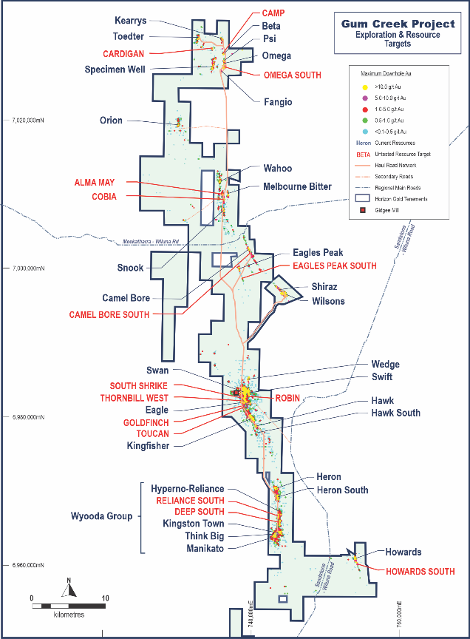
Exploration Upside
Resource Upside
Excellent brownfields resource upside across the 80km strike of Gum Creek Gold Project
Excellent recent assay results from infill and extension resource drilling included:
  Swan/Swift Prospects: 22m @ 3.18g/t Au from 2m including 5m @ 9.71g/t Au from 10m*
  Howards Prospect: 28m @ 3.88g/t Au from 74m including 12m @ 8.19g/t Au from 77m*
  Eagle Prospect: 14m @ 4.34g/t Au from 24m including 3m @ 18.66g/t Au from 32m**
Results from 4,400m of resource extension RC drilling are pending
Further drilling at numerous untested resource targets in planning
Diamond drilling at Kingfisher and Omega high-grade underground targets is underway
Continuous Resource Growth*** (Moz Au)
2.14
2.30
1.79
1.36
Source: * Refer to Horizon Gold Limited ASX Announcement titled “Impressive broad, shallow and high-grade intercepts returned from RC and Diamond Drilling" dated 3 June 2025.
** Refer to Horizon Gold Limited ASX Announcement titled “Additional impressive high-grade intercepts returned from RC and Diamond Drilling” dated 30 June 2025.
*** Refer to Horizon Gold Limited ASX announcements titled “Gum Creek Gold Project Resource Update” dated 12 February 2021, “32% Increase in Resources at Gum Creek Gold Project” dated 25 July 2022, “19% Increase in Gold Resources at Gum Creek Project” dated 15 May 2023 & “Gum Creek Project Resource Update" dated 4 November 2025.
Notes:
GCGM has completed almost 88,000m of drilling across the Gum Creek Gold Project in the past 6 years and added over 940,000oz of gold to its resource base. Using $150/m that’s an approx. discovery cost of $14/oz

Slide 8
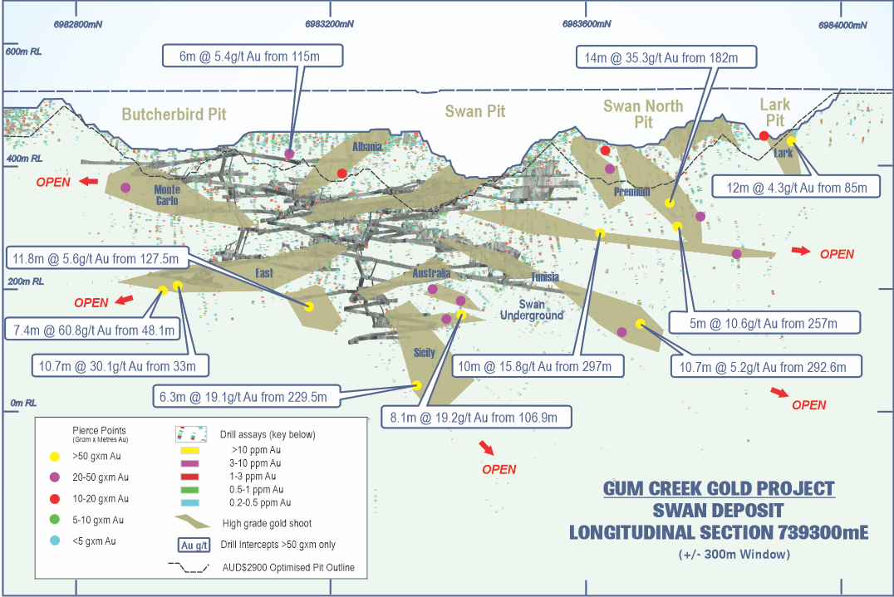
Swan Underground Potential
Largest free milling high-grade underground resource
Swan Underground MRE reported as 1.73Mt @ 4.19g/t Au for 233,700 ounces (57% Indicated)*
Moderate NE dipping and shallow SE dipping conjugate vein sets emanating from the broader north-south steeply dipping shear zone (Gidgee Shear)
Significant amount of unmined high-grade shoots near existing underground mining infrastructure
Long section of Swan deposit showing A$2,900 optimised pit shells (blue), >50GxM unmined intercepts, interpreted high-grade gold shoots and existing underground workings**
Source: * Refer to Horizon Gold Limited ASX Announcement titled “Gum Creek Project Resource Update" dated 4 November 2025 for further information.
** Refer to Horizon Gold Limited ASX announcement titled “Gum Creek Geological Review” dated 15 February 2021 & “Significant RC Drilling Results from Swift, Swan and Eagle Targets” dated 16 June 2021 for drilling intercept information.

Slide 9
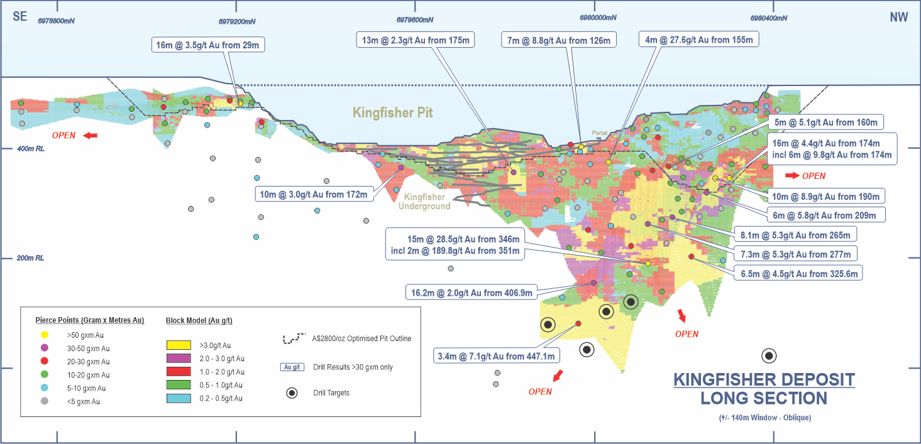
Gidgee Shear Zone – Kingfisher Deposit
Permitted, High-Grade Deposit Near Mill with Proven Production History, and significant exploration potential
High-Grade Historical Production: Between 1990 and 1996, the Kingfisher deposit yielded 265koz of gold from open-pit operations at an average grade of 4.0g/t and 27koz from underground mining at an impressive 14.1g/t
Substantial Existing Resource: The current MRE for Kingfisher stands at 2.26Mt @ 2.65g/t, totalling 192.4koz*
Strategic Location: Situated approximately 3.5 km south of the Gidgee Mill, the Kingfisher deposit benefits from proximity to existing infrastructure, reducing potential development costs
Open-Ended Mineralisation: The deposit features a 1.2 km strike length with mineralisation remaining open along strike and at depth, suggesting significant potential for resource expansion
Recent High-Grade Drill Intercepts: Exploration has returned exceptional results, including 15m @ 28.5g/t from 346m and 10m @ 8.9g/t from 190m**, indicating the presence of high-grade zones at depth
Drilling planned to test for better grades down plunge at depth
Source: * Refer to Horizon Gold Limited ASX announcement titled “Gum Creek Project Resource Update" dated 4 November 2025.
**Refer to Horizon Gold Limited ASX announcement titled “Diamond drilling returns 15m @ 28.5g/t Au from Kingfisher" dated 12 December 2022.
Historical production data has been sourced from: Hazard N J 1998 - Kingfisher gold deposit, Gidgee: in Berkman D A, Mackenzie D H (Ed.s), 1998 Geology of Australian & Papua New Guinean Mineral Deposits The AusIMM, Melbourne Mono 22 pp 123-126

Slide 10
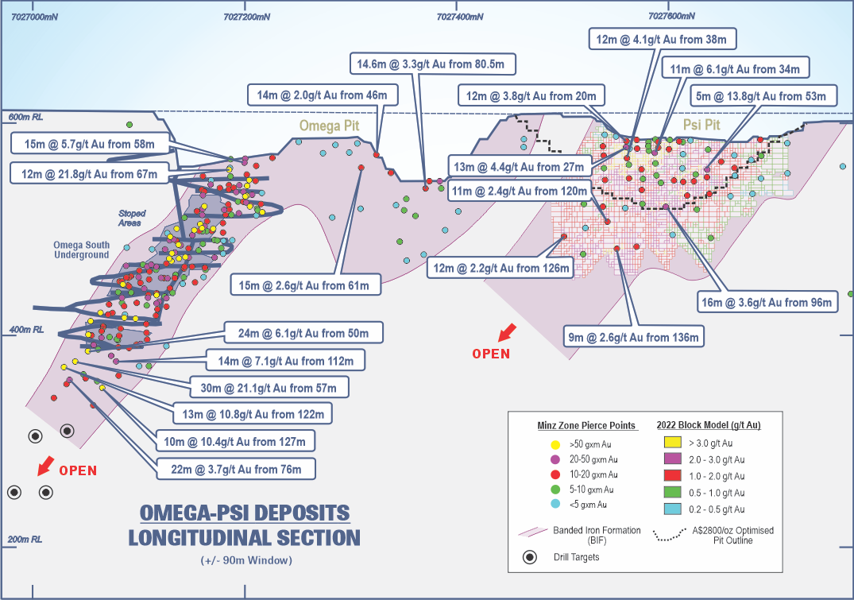
Omega Exploration Potential
High-grade exploration potential
High-Grade Production History: Omega Pit previously produced 44koz @ 5.4g/t, while the Omega Underground delivered 40koz @ 5.3g/t, demonstrating consistent high-grade mineralisation across previous mining phases
Drilling planned at Omega to follow up historical drilling intercepts not mined
  Omega down-plunge extensions including:
    30m @ 21.1g/t Au from 57m
    13m @ 10.8g/t Au from 122m
    24m @ 6.1g/t Au from 50m
    10m @ 10.4g/t Au from 127m
    14m @ 7.1g/t Au from 112m
    22m @ 3.7g/t Au from 76m
Source: Refer to Horizon Gold Limited ASX announcement titled “Gum Creek Geological Review” dated 15 February 2021 for drilling intercept information. Historical production data has been sourced from: Ross, D I and Smith, D W, 1998. Omega gold deposit, Gidgee, in Geology of Australian and Papua New Guinean Mineral Deposits (Eds: D A Berkman and D H Mackenzie), pp 119–122 (The Australasian Institute of Mining and Metallurgy: Melbourne).

Slide 11
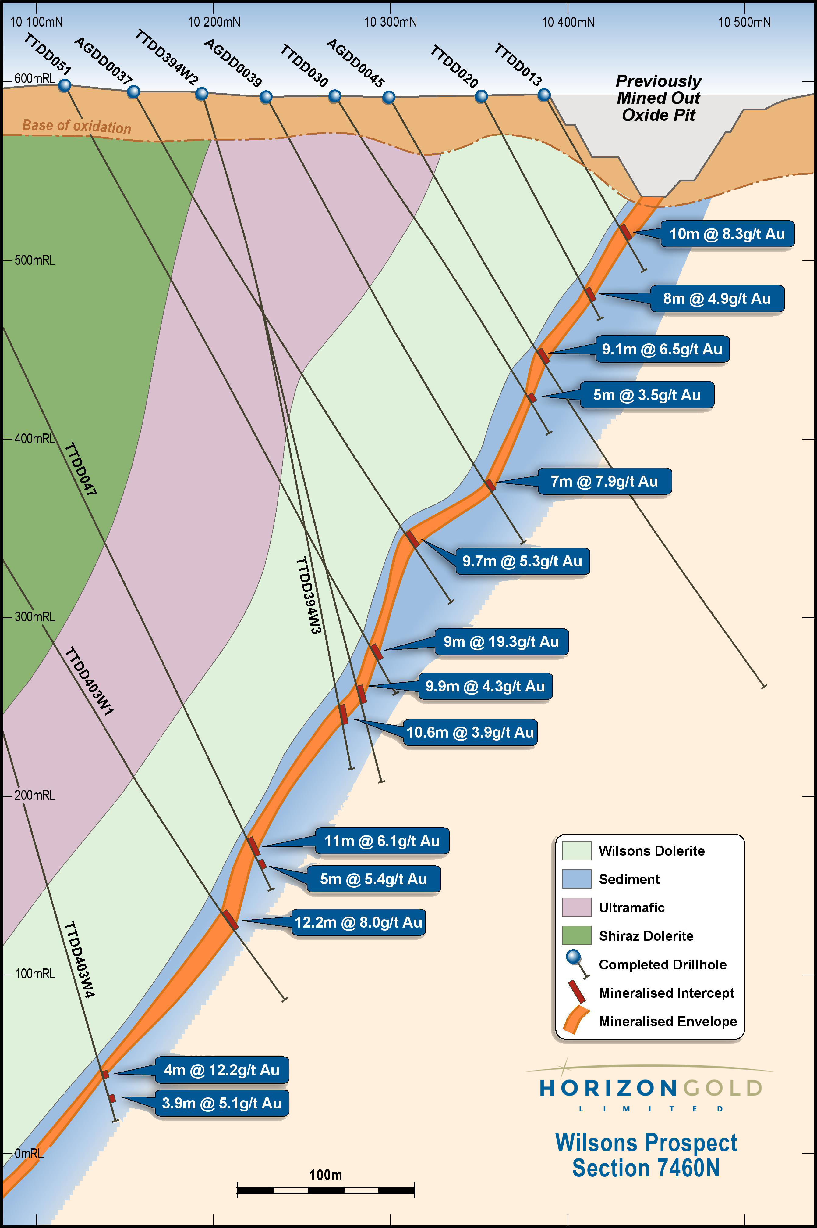
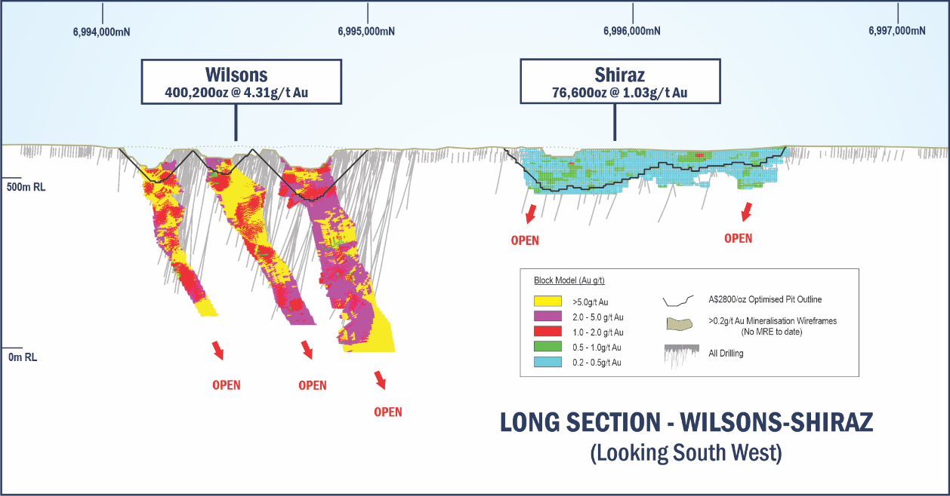
Wilsons – High Grade U/G Optionality
Permitted, High-Grade Resource to Extend Mine Life
Large, High-Grade Sulphide Resource Not Yet in Development Plan: Wilsons hosts a 400koz resource @ 4.31g/t (97% Indicated)*, offering a significant inventory of high-grade gold not currently included in the Scoping or Feasibility Studies.
Outstanding Historical Intercepts Indicate Depth Continuity: Historical diamond drilling has returned strong down-plunge results, supporting the view that mineralisation continues at depth and may be expanded with further drilling.
Metallurgy Well Understood: Test work has delivered strong gold recoveries of 87–90%, with conventional processing routes for refractory ore applicable (Albion process). This supports the optionality to integrate Wilsons into the Gum Creek development or toll treating at a later stage.
Permitting Advantage: Like the broader project resources, Wilsons sits on granted mining leases, with a history of exploration and development that streamlines future permitting or restart pathways.
Source: * Refer to Horizon Gold Limited ASX announcement titled “Gum Creek Project Resource Update" dated 4 November 2025.
Refer to Panoramic Resources Limited ASX Announcements titled “Corporate Strategy and positive gold results” dated 27 June 2016 for metallurgy information & titled “Quarterly Report for the period ending 30 September 2013” dated 21 October 2013 for cross section information

Slide 12
March 2024 Scoping Study – attractive base case economics
Key Economic Metrics
Cashflow and Cumulative Cashflow p.a. (A$m @ A$3300/oz)
Life of Mine | Years | 10
Gold Price | A$/oz | 3,300
Pre-production Capital Costs | A$m | 239
LoM Capital Costs | A$m | 333
Annual Gold Production | koz p.a | 84
LoM Gold Production | koz | 888
Payback Period | Years | 2.1
LoM EBITDA | A$m | 904
AISC | A$/oz | 1,931
Source: Refer to Horizon Gold Limited ASX announcement titled “Compelling Gum Creek Scoping Study” dated 20 March 2024. The mining production target and forecast financial information referred to in the Gum Creek Scoping Study includes Indicated Mineral Resources (approximately 76%) and Inferred Mineral Resources (approximately 24%). The Inferred material does not have a material effect on the technical and economic viability of the Gum Creek Gold Project. There is a low level of geological confidence associated with Inferred Mineral Resources and there is no certainty that further exploration work will result in the determination of Indicated Mineral Resources or that the production target itself will be realised.

Slide 13
Feasibility Study on track for completion 1H 2026
Open Pit Mining of Free Milling Resources on Granted Mining Leases
Targeting simple base-case operation underpinned by two open pit mining areas, the Gidgee Shear Zone and Howards open pit
Mine plan only includes 7 of the 26 resource areas (81% of the free milling resource)
All gold resources in the Study are located on granted mining leases within the 100% owned Gum Creek Gold Project
Key workstreams
Feasibility resource drilling and geotechnical drilling completed with results announced
MRE update completed
Geotechnical, geochemical and metallurgical test work completed - reports being finalised
Process plant design, mine layout, waste rock dump and pit designs completed
Mining schedule being finalised
Water bore drilling completed, groundwater model completed, water balance model and surface water infrastructure designs being finalised
Power study completed and environmental surveys completed - reports being finalised
Heritage surveys completed and consent to mine received - reports being finalised
Completion of the Feasibility Study on track for completion 1H CY2026

Slide 14


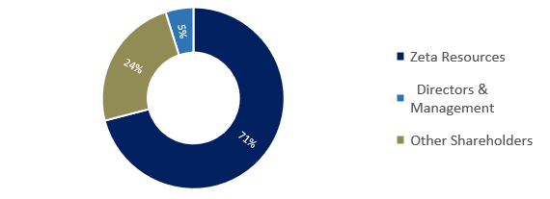
CORPORATE OVERVIEW
Capitalisation Summary *
Shareholder Summary
 | Unit | ASX:HRN
Share Price | A$ | 0.73
Shares Outstanding | M | 169.6
Market Capitalisation | A$m | 123.8
Cash (30 September 2025) | A$m | 8.2
Debt (30 September 2025) | A$m | 0
Enterprise Value | A$m | 115.6
12 Month Share Price and Trading Volumes*
Key Board and Management
Leigh Ryan
Managing Director
Qualified geologist with 30+ years of experience across Australia and Africa
Previously held senior leadership roles at Resolute Mining, Boss Resources, Chrysalis Resources and Alchemy Resources
Peter Sullivan
Executive Chairman
Over 30+ years of experience in the resources sector across project engineering, corporate finance and public company directorships
Previous directorships in Zeta Resources and Alliance Nickel
Notes: * As at 19 November 2025

Slide 15
APPENDICES

Slide 16
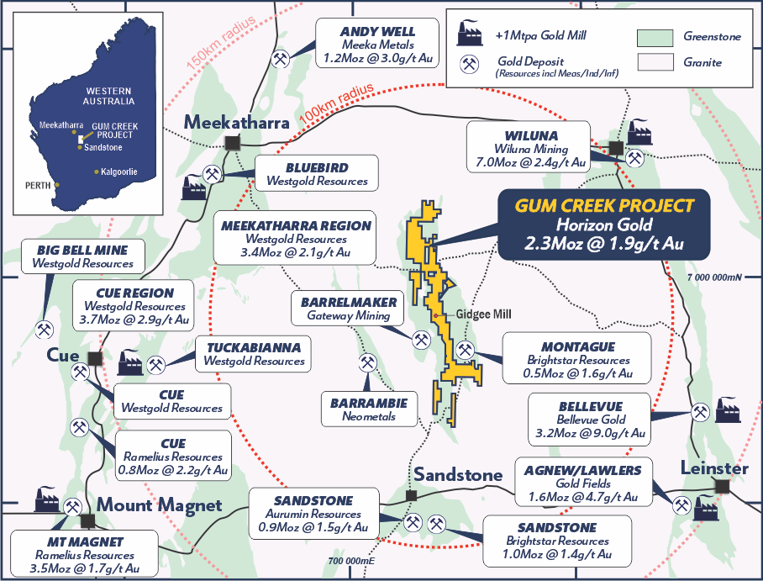
Gum Creek Gold Project Location
Gum Creek Gold Project
Strategic project within the prolific Sandstone / Gum Creek gold mining district located between the gold mining townships of Meekatharra, Wiluna and Sandstone
Gum Creek Gold Project has one of the largest landholdings in the district and the largest resource at 2.3Moz Au.
Strategically located - 6 gold mills within 150km of the project

Slide 17
GUM CREEK GOLD PROJECT RESOURCE ^{1,2}
Source: (1) Refer to Horizon Gold Limited ASX Announcement titled “Gum Creek Project Resource Update" dated 4 November 2025 for more information. (2) Figures are rounded.
* cut-off grades are 1.5g/t Au for Swan UG, Swift UG, Wilsons UG and Kingfisher UG.
** Wyooda includes the Kingston Town, Think Big and Manikato resources.

Slide 18
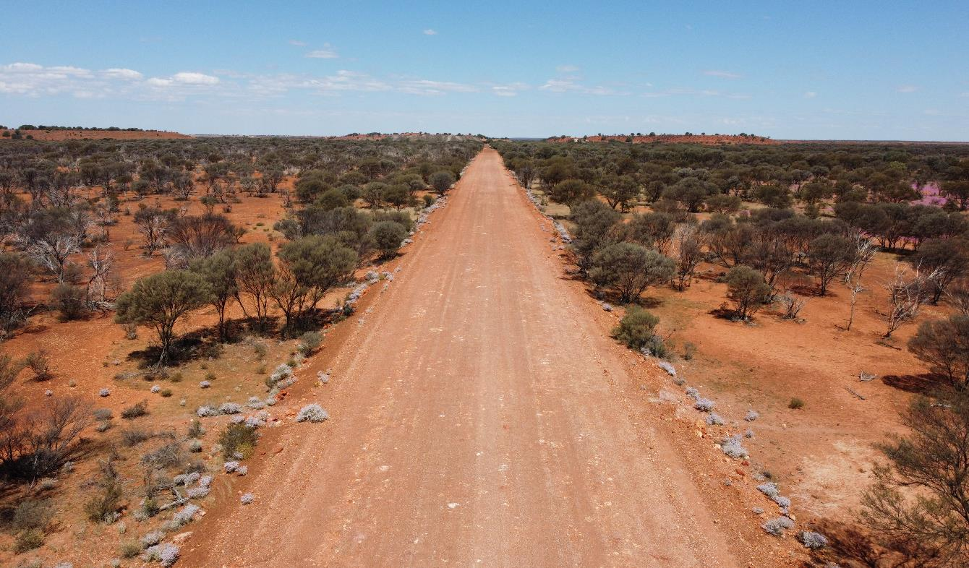
CONTACT DETAILS
Peter Sullivan
Executive Chairman
Leigh Ryan
Managing Director
+61 8 6331 6092
info@horizongold.com.au
horizongold.com.au
Unit 8 / 47 Havelock St.
West Perth, WA 6005
ASX: HRN
Haul Road to the Gidgee Mill

