Slide 1


Company Update
April 2018
ASX.OSL
Advancing Pancreatic Cancer Treatment

Slide 2
OncoSil Medical | Investment Highlights
1
Clear
mission
Commercialising a breakthrough implantation radiation treatment for Pancreatic cancer
2
Sound
science
Current and previous clinical studies demonstrate:
Excellent Local Disease Control
Significant reduction in tumour size and volume
Excellent safety and tolerability profile
Ease of implantation
3
Clear strategic
path
Targeting >$2bn market opportunity to improve standard of care
US FDA-approved IDE in place, safety run-in underway
EU regulatory approval, CE Marking expected near-term
Highly experienced management team; strong clinical and commercial pedigree
Manufacturing and logistics optimised for supply of commercial quantities
At a potential value inflection point with multiple paths to commercialisation

Slide 3
OncoSil Medical
OncoSilTM is a first in class medical device for the treatment of unresectable locally advanced pancreatic cancer
First in class technology
Proprietary brachytherapy (internal radiation) medical device
Cancer is treated by implantation of radioactive micro-particles into a tumour via ultrasound guided endoscopy with negligible surrounding healthy tissues damage
Patent protected in all major geographies
Class III Medical device in the US and AIMD in EU
Share price performance (1 year)
Share price (acps)
Volume (m)
Financial information
Share price (as at 6-Apr-18) ¹ | A$0.125
52 week range | A$0.08-0.18
Shares on Issue | 557.5m
Market capitalisation | A$69.7m
Cash (31 December 2017) | A$5.2m
Debt (31 December 2017) | Nil
Enterprise value | A$64.5m
Substantial shareholders
Regal Funds Management | 10.6%
Management and Directors | 12.3%
Note: 1. Includes 72.7m Tranche 1 placement shares (issued 28 March) , with a further 33.3m Tranche 2 placement shares expected to be issued following Extraordinary General Meeting to be held on 4 May 2018 and shares issued under the Share Purchase Plan to raise up to A$4.0m

Slide 4
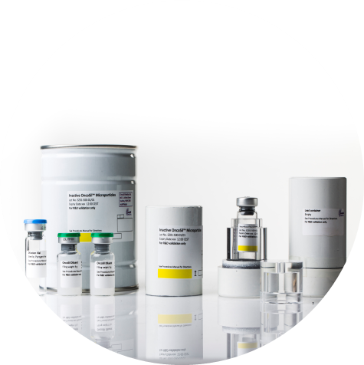
About the OncoSilTM device
An implantable radiotherapy medical device targeting pancreatic cancer
OncoSilTM is a single-use brachytherapy device
Delivered through microparticles: 30-micron silicon particles contain beta-emitting Phosphorus-32 (³²P)
OncoSilTM Microparticles are inserted directly into
the tumour
Radiation from the microparticles causes direct damage to cancer cell DNA. The device being active for approximately 3 months after implantation
Microparticles stay in the tumour permanently

Slide 5
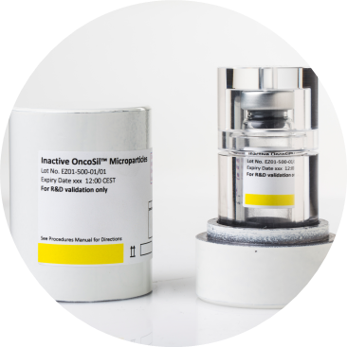
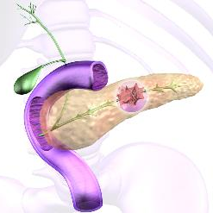
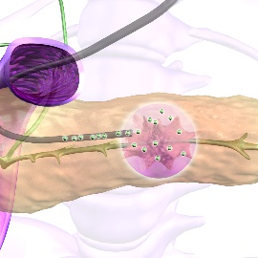
Implantation procedure
Studies continue to show the device implantation is technically straightforward
Endoscope guided into the upper intestine
Using CT or real-time imaging, the needle is guided into the target lesion (tumour)
OncoSil™ injected directly into the tumour
OncoSilTM dose is suspended in a specially formulated fluid for implantation

Slide 6
OncoSil at a potential value inflection point
The Company is well positioned to realise value of OncoSil™ device
Current focus
Before 2015:
Demonstrate potential
2016 to 2018:
Satisfy regulatory obligations
2018 onwards:
Path to
commercialisation
4 studies show potential of OncoSil™ to treat pancreatic & primary liver (HCC) cancer
Secured US FDA IDE approval
Initiated PanCO & OncoPac-1 clinical studies
Highly positive early safety, efficacy and implant delivery data consistent with results from previously completed studies
Secure strategic partnerships and licensing agreements in all key geographies
Secure licensing agreements in unique geographies
Leverage potential for broader distribution, capital and market support and exposure

Slide 7



Clinical pathway overview
PanCO and OncoPaC-1 to inform future studies
Phases:
Current focus
2 concurrent trials, targeting 65 patients total
Future focus
Studies to drive clinical adoption (EU & global)
and secure US FDA approval
Trials:
PanCO – 45 patients
Open label study in patients with unresectable locally advanced pancreatic cancer with Oncosil given in combination with SOC chemotherapy
Company exploring clinical study options in resectable, borderline resectable and locally advanced pancreatic cancer indications.
Final decision on future studies to be taken based on data received from ongoing studies and feedback from US FDA*
Future trials to drive clinical adoption in EU and to generate data for US FDA approval (PMA)
Current
trials inform
future trials*
.
OncoPaC-1 – 20 patients
Open label study in patients with unresectable locally advanced pancreatic cancer with Oncosil given in combination with SOC chemotherapy
Regulatory
milestones:
CE Mark: Company to provide 16 week data for first 20 patients to EU Notified Body by 31 May 18
FDA approval
*FDA granted OncoSil an IDE (July 2016) and has requested 20 patient safety run. 10 patients must come from OncoPaC-1

Slide 8
PanCO study – positive results to date
Positive clinical data on 20 patients (at Week 8) and 14 patients (at Week 16)
Study progress overview
40 patients enrolled¹
31 patients implanted¹
Disease Control Rate (DCR) of 100% (Week 8) and 87% (Week 16)
Up to 73% and 72% tumour volumetric reduction at Week 8 and 16 respectively
Median volumetric reduction of 29% (at week 8) and 39.5% (as week 16)
Clinical
performance
4 out of 20 implanted patients
achieved a Partial Response
3 out of 20 implanted patients have undergone Surgical Resection
Partial Response – a reduction in tumour longest diameter of at least 30% from baseline
Resection – the only potential cure for pancreatic cancer, demonstrating possibility of improved outcomes in patient group deemed inoperable at time of study entry. A further 3 study participants are being assessed for possible surgical resection
Safety & implantation
No Serious Adverse Events (SAEs) attributed to device or implantation²
No evidence of radiation toxicities, or other safety concerns identified to date
OncoSil™ device delivery via EUS considered straightforward for implantation
As at 6-Apr-18
SAEs related to chemotherapy or cancer progression

Slide 9
Tumours successfully resected
Recap of study context
Study population drawn from patients with unresectable locally advanced pancreatic cancer
Primary objective of treatment with OncoSil for these patients is to control tumour growth
To date, 3 out of 20 implanted patients have undergone surgical resection with curative intent (undergoing the Whipple procedure)
In addition, 3 other study participants are being assessed by their clinical team for surgical resection
SIGNIFICANT MILESTONE FOR PanCO STUDY
Demonstrates improved outcomes in group of patients deemed inoperable at time of enrolment
RESECTION IS THE ONLY CURE FOR PANCREATIC CANCER
But <15% of all diagnosed pancreatic cancer patients will be eligible for surgical resection
CONTINUED PROGRESS WILL BE CLOSELY MONITORED
Down-staging patients to resection is not an objective endpoint in the PanCO study, however will be closely followed as more data is collected.

Slide 10



















Partnering with leading cancer centres
15 leading cancer centres participating in Global Pancreatic Cancer clinical programme
Region | Centre
 | MD Anderson, Texas
 | Johns Hopkins, Maryland
 | Moffit Cancer Centre Florida
 | Cedars Sinai Hospital, LA
 | Guy’s & St Thomas’, London
 | University of Leicester
 | Hammersmith, London
 | Addenbrookes, Cambridge
 | Monash, Melbourne
 | St Vincent’s, Sydney
 | Westmead Hospital, Sydney
 | RNS Hospital, Sydney
 | Royal Adelaide
 | The Austin Hospital, Melbourne
 | Jules Bordet Institute Hospital, Brussels

Slide 11




Clear pathway to commercialisation
Strategic partners provide multiple paths to market to optimise value
Well positioned for commercialisation
Potential paths to market
Broad technology platform
Treatment for multiple solid tumours
Strategic licensing partners in all key geographies
EU
US
Excellent clinical results
Pancreatic and primary liver cancer
EU regulatory approval
CE Mark certification for pancreatic cancer expected near-term
Additional licensing partners in unique geographies
China
Japan
India
Significant unmet clinical need
Over130,000 patients diagnosed with pancreatic cancer in US and EU every year
2018 marks the start of this journey
1. GLOBOCAN 2012: Estimated Cancer Incidence Worldwide in 2012 (IARC/WHO).
Accessed 22 Apr 2016,from http://globocan.iarc.fr/Pages/fact_sheets_population.aspx

Slide 12
UK(Launch market) ^{1,2}
Pancreatic cancer | 8,747
Liver cancer | 4,186
European Union^{1,2}
Pancreatic cancer | 79,331
Liver cancer | 51,785
Target markets
Annual incidence
China^{1,2}
Global opportunity
Pancreatic cancer | US>$2.0bn
Liver cancer | US$1.4bn
United States ^{1,2}
Pancreatic cancer | 65,727
Liver cancer | 351,000
Pancreatic cancer | 42,885
Liver cancer | 30,449
Australia/NZ^{1,2}
GLOBOCAN 2012: Estimated Cancer Incidence Worldwide in 2012 (IARC/WHO). Accessed 22 Apr 2016, from http://globocan.iarc.fr/Pages/fact_sheets_population.aspx
Datamonitor Healthcare 2013
OncoSil dose pricing, $USD 25,000
Pancreatic cancer | 3,350
Liver cancer | 1,954

Slide 13
Global Commercial opportunity in excess of $2bn
130,000 cases per year in US+EU alone: more than 70,000 of these could benefit from OncoSil
More than 70,000 relevant patients in EU and US alone
Company exploring clinical research options in re-sectable & borderline re-sectable patients
OncoSil’s potential pricing of US$25,000 per patient (in-line with other on-market devices) implies >$2bn global market opportunity
Locally advanced
35-40%
OncoSil™ provides a suitable treatment to control the growth of the primary tumour and provide meaningful reductions in pain
Surgical re-section
15%
OncoSil™ could be used to downstage tumours prior to surgery to improve surgical outcomes
Pancreatic cancer
Metastatic disease
40-45%
Unlikely to benefit overall survival but OncoSil™ may be used to control tumour growth, alleviate pain and improve quality of life

Slide 14
OncoSil’s commercial path has precedent
Sirtex provides a useful case study to demonstrate the potential commercial journey for OncoSil due to similarities in addressable market
24-Aug-00
Listed on the ASX with Phase II and Phase III clinical trials completed for SIR-Spheres
5-Mar-02
FDA approval for SIR-spheres achieved
23-Oct-02
European approval granted
9-Dec-02
First patient treated in the EU
A$m
Ramp up in SIR sales and market capitalisation post European approval
A$m

Slide 15






Sector M&A trends
Over A$2bn of acquisitions in February 2018 highlights attraction of early-stage Australian biotech to global pharmaceutical players
Acquiree
Acquirer
Consideration
A$1.6 billion¹
30 Jan 2018
60% (1 month VWAP)²
Brachytheraphy
Complete
A$502 million¹
22 Feb 2018
160% (1 month VWAP)²
Oncolytic immunotherapy
Currently under offer
A$120 million¹
6 Feb 2018
Private company
Injectable tropoelastin
Subject to FIRB approval
Date
Premium
Technology
Deal status
Note:
Based on disclosed consideration
Based on disclosed premium to target’s volume weighted average price prior to announcement

Slide 16
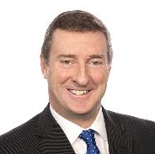
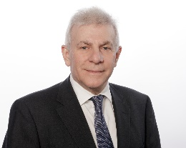
Board of Directors
Board and management are experienced leaders in the pharmaceutical and medical device space, having held senior positions at Cochlear (ASX:COH), Sirtex Medical (ASX:SRX), ABIVAX, Baxter International, Roche and more
Extensive leadership experience guiding products from clinical development to commercialisation
120+ years collective experience in the health care industry
Dr Chris Roberts
Chairman
Former CEO/President of Cochlear (ASX:COH)
40+ years’ industry experience
Former Chairman of Sirtex (ASX: SRX) & Executive Vice-President of ResMed (ASX: RMD)
Mr Daniel Kenny
CEO & MD
Proven biopharma professional, leading multiple $1bn+ franchises
30+ years industry experience
Commercial development at ABIVAX & global strategic marketing & business development at Roche
Dr Roger Aston
Non Executive Director
Biotech & pharma entrepreneur
20+ years industry experience
Founder & former CEO of pSiMedica & pSiOncology
FDA & EU registration, global licensing & equity capital raisings experience
Martin Cross
Non Executive Director
Former Chairman of Medicines Australia
Highly regarded pharmaceutical executive with 30+ years experience in corporate & industry leadership roles

Slide 17
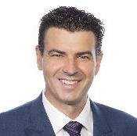
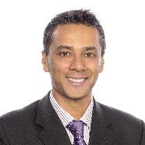
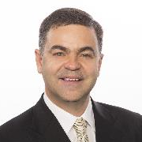
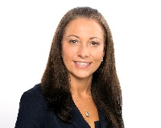
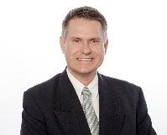
Highly experienced management team
Revamped leadership team
Management team experienced leaders in the medical device space having held senior positions at Sirtex Medical (ASX:SRX)
Extensive leadership experience in clinical studies, commercialisation and manufacturing & operations
Mr Daniel Kenny
CEO & MD
Proven biopharma professional, leading multiple $1bn+ franchises
30+ years industry experience
Commercial development at ABIVAX & global strategic marketing & business development at Roche
Mr Tom Milicevic
Chief Financial Officer
& Company Secretary
Seasoned CFO with over 15+ years experience in the Medical Device sector
Experience in investor relations and also Company Secretary duties
Dr Ashish Soman
Chief Medical Officer
Former country medical
director, AstraZeneca Australia.
20+ years’ experience in clinical practice & the biopharmaceutical industry
Dr David James
Manufacturing &
Operations Manager
Ex Sirtex Medical global operations manager for 6 years
Established Sirtex’s manufacturing and operations
25 years experience in
pharmaceutical operations
Nicole Wilson
VP Regulatory Affairs & Quality
Regulatory affairs specialist focused on quality compliance and marketing registrations in the Asia, South America and middle East.
Principal for the regulatory approvals in Brazil, Argentina and UAE for Sirtex.
Michael Warrener
Global Sales & Marketing Director
Former Sirtex Medical Senior Executive
Introduced Sir-Spheres in Australia, EU and Middle East markets

Slide 18
Key catalysts in CY 2018
Revamped leadership team
CE Mark
Target submission of 16 week 20 patient supplemental data to BSI by 31-May-18
Target CE Mark certification
Target EU first sales
Global Pancreatic Clinical Study programme
Continued recruitment into the Global Pancreatic Cancer clinical study program, (PanCO & OncoPaC-1): 38 patients currently enrolled
OncoPaC-1 trial progress
Congress presentation of latest patient data from clinical programme
Strategic partnerships
Securing strategic partnerships and licensing agreements in key geographies
Additional Licensing partners in unique geographies

Slide 19
Important notice
This Presentation has been prepared by OncoSil Medical Ltd (ASX:OSL) (OncoSil or the Company) to provide an overview of the Company. This Presentation and the information contained may require further explanation and/or clarification. Accordingly, this Presentation and the information contained should be read in conjunction with past and future ASX announcements made by OncoSil and should not be relied upon as an independent source of information. Please contact OncoSil and/or refer to the Company's website www.oncosil.com.au for further information.
Not an Offer for Securities
Nothing in this Presentation constitutes investment advice or should be construed as either an offer to sell or a solicitation of an offer to buy or sell shares in the Company, in any jurisdiction.
Forward-Looking Statements
This document contains certain forward-looking statements as at the date of this presentation relating to OncoSil’s business, which can be identified by the use of forward-looking terminology such as “promising”, “plans”, “anticipated”, “will”, “project”, “believe”, “forecast”, “expected”, “estimated”, “targeting”, “aiming”, “set to”, “potential”, “seeking to”, “goal”, “could provide”, “intends”, “is being developed”, “could be”, “on track”, or similar expressions, or by express or implied discussions regarding potential filings or marketing approvals, or potential future sales of product candidates. Such forward-looking statements involve known and unknown risks, uncertainties and other factors that may cause actual results to be materially different from any future results, performance or achievements expressed or implied by such statements. There can be no assurance that any existing or future regulatory filings will satisfy the FDA and other national and international authorities’ requirements regarding any one or more product candidates, nor can there be any assurance that such product candidates will be approved by any authorities for sale in any market or that they will reach any particular level of sales, nor that that any specific objective of the Company will be achieved or that any particular performance of the Company or of its shares will be achieved. In particular, the Company's expectations regarding the approval and commercialisation of the product candidates could be affected by, amongst other things, unexpected trial results, including additional analysis of existing data, and new data; unexpected regulatory actions or delays, or government regulation generally; changes in legislation or regulatory requirements, our ability to obtain or maintain patent or other proprietary intellectual property protection; competition in general; government, industry, and general public pricing pressures; and additional factors that involve significant risks and uncertainties about our Company, products, product candidates, financial results and business prospects. Should one or more of these changes, risks or uncertainties materialize, or should underlying assumptions prove incorrect, actual results may vary materially from those described herein as anticipated, believed, estimated or expected. OncoSil is providing this information as of the date of this document and does not assume any obligation to update any forward-looking statements contained in this document as a result of new information, future events or developments or otherwise. You are urged to consider all of the above and advice from your own advisers carefully in evaluating the forward-looking statements and are cautioned not to place undue reliance on the forward-looking statements. The information in this presentation is not financial product advice, is not an offer to invest in the securities of OncoSil and does not take into account your investment position or objectives, financial situation or any particular requirements.
Disclaimer
This Presentation and any supplemental materials have been prepared by OncoSil based on available information. Although reasonable care has been taken to ensure the facts stated in this presentation are accurate and that the opinions expressed are fair and reasonable, no representation or warranty, express or implied, is made as to the fairness, accuracy, completeness, or correctness of such information and opinions and no reliance should be placed on such information or opinions. To the maximum extent permitted by law, none of OncoSil or any of its members, directors, officers, employees, or agents or corporate advisors, nor any other person accepts any liability whatsoever for any loss, however arising, from the use of the presentation or its contents or otherwise arising in connection with it, including, without limitation, any liability arising from fault or negligence on the part of OncoSil or any of its directors, officers, employees or agents.

Slide 20
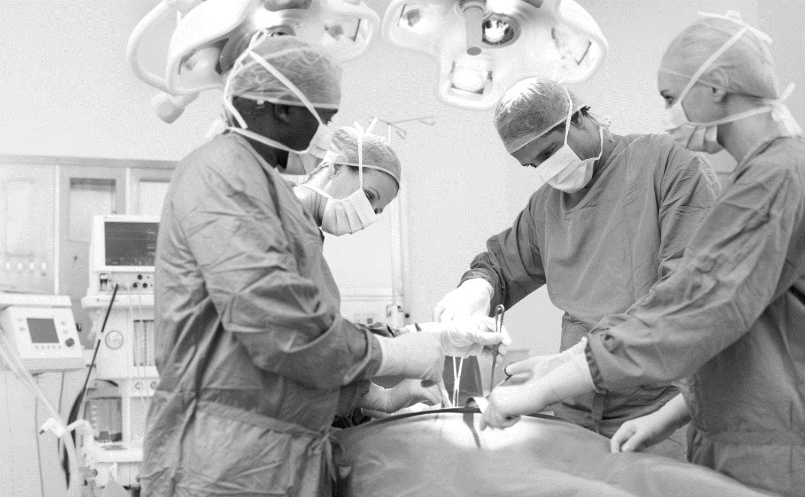

Daniel Kenny
CEO & Managing Director
E: daniel.kenny@oncosil.com.au
OncoSil Medical Ltd
www.oncosil.com.au
T: +61 2 9223 3344
F: +61 2 9252 3988

