Slide 1

April 2011

Slide 2
Disclaimer
This Document comprises an institutional presentation (the “Presentation”) which has been prepared by and is the sole responsibility of ValiRx plc (the “Company”).
The content of this promotion has not been approved by an authorised person within the meaning of the Financial Services and Markets Act 2000. Reliance on this promotion for the purpose of engaging in any investment activity may expose an individual to a significant risk of losing all of the property or other assets invested.
WH Ireland Limited (“WHI”), which is authorised and regulated by the Financial Services Authority, is the Company’s nominated adviser and broker for the purpose of the AIM Rules. WHI’s responsibilities as the Company’s nominated adviser under the AIM Rules are owed solely to the London Stock Exchange plc and are not owed to the Company or to any Director or any other person. WHI is acting for the Company and no one else and will not be responsible to any other person for providing the protections afforded to customers of WHI nor for providing advice in relation to the arrangements described in this Presentation.
This Presentation does not constitute or form part of any offer for sale or solicitation of any offer to buy or subscribe for any securities nor shall it or any part of it form the basis of or be relied on in connection with, or act as any inducement to enter into, any contract or commitment whatsoever or constitute an invitation or inducement to engage in investment activity under section 21 of the UK Financial Services and Markets Act 2000.
Notwithstanding the above, in the United Kingdom, this Presentation is only being given to persons reasonably believed by the Company to be investment professionals within the meaning of paragraph (5) of Article 19 or to high net worth companies or unincorporated associations within the meaning of paragraph (2) of Article 49 of the Financial Services and Markets Act 2000 (Financial Promotion) Order 2005 (SI 2005/1529). This Presentation is only being sent to persons reasonably believed by the Company to be investment professionals or to persons to whom it may otherwise be lawful to distribute it. If you are not such a person (i) you should not have received this Presentation and (ii) please return this Presentation to the Company's registered office as soon as possible and take no other action. By accepting this Presentation the recipient represents and warrants that they are a person who falls within the above description of persons entitled to receive this Presentation.
This Presentation is not intended to be distributed, or passed on, directly or indirectly, to any other class of person and in any event under no circumstances should persons of any other description rely or act upon the contents of this Presentation. This Presentation and its contents are confidential and must not be distributed or passed on, directly or indirectly, to any other person. This Presentation is being supplied to you solely for your information and may not be reproduced, further distributed or published in whole or in part by any other person.
No representation or warranty, express or implied, is made or given by or on behalf of the Company, its advisers or any of their respective parent or subsidiary undertakings or the subsidiary undertakings of any such parent undertakings or any of the directors, officers or employees of any such person as to the accuracy, completeness or fairness of the information or opinions contained in this Presentation and no responsibility or liability is accepted by any person for such information or opinions. No person has been authorised to give any information or make any representations other than those contained in this Presentation and, if given and/or made, such information or representations must not be relied upon as having been so authorised. The contents of this Presentation are not to be construed as legal, financial or tax advice.
The information has not been verified nor independently verified by the Company’s advisers and is subject to material updating, revision and further amendment.
The Company has not been, and will not be, registered under the United States Investment Company Act of 1940, as amended, and investors will not be entitled to the benefits of that Act. Neither this Presentation nor any copy of it may be taken or transmitted into the United States of America or its territories or possessions (the “United States”), or distributed, directly or indirectly, in the United States, or to any U.S Person as defined in Regulation S under the Securities Act 1933 as amended, including U.S resident corporations or other entities organised under the laws of the United States or any state thereof or non-U.S branches or agencies of such corporations or entities or into Canada, Australia, Japan, South Africa or the Republic of Ireland. Neither this Presentation nor any copy of it may be taken or transmitted into or distributed in Canada, Australia, Japan, South Africa or the Republic of Ireland, or any other jurisdiction which prohibits the same except in compliance with applicable securities laws. Any failure to comply with this restriction may constitute a violation of United States or other national securities law.
Forward-Looking Statements. Information contained in this Presentation may include 'forward-looking statements'. All statements other than statements of historical facts included herein, including, without limitation, those regarding the Company's financial position, business strategy, plans and objectives of management for future operations (including development plans and objectives relating to the Company's business) are forward-looking statements. Such forward-looking statements are based on a number of assumptions regarding the Company's present and future business strategies and the environment in which the Company expects to operate in future. Actual results may vary materially from the results anticipated by these forward-looking statements as a result of a variety of factors. These forward-looking statements speak only as to the date of this Presentation and cannot be relied upon as a guide to future performance. The Company expressly disclaims any obligation or undertaking to disseminate any updates or revisions to any forward-looking statements contained in this Presentation to reflect any changes in its expectations with regard thereto or any change in events, conditions or circumstances on which any statement is based.

Slide 3
Overview
Biopharmaceutical company specialising in oncology therapeutics and diagnostics
  Listed on AIM 2006
Portfolio of innovative technologies and products with worldwide exclusive rights and granted patents
Two complementary sections with strong development pipelines
  Marketing and Distribution- online distribution www.valimedix.com
    Revenues from Self-Check diagnostic products
  Therapeutics and companion diagnostics
    Late pre-clinical leading to clinical trials
Balanced risk, reward through diagnostics and therapeutics
  Develop diagnostics through distribution, marketing authorisation and partner
  Develop therapeutics through proof of concept in man
  and then license and/or partner
Partners
  Cancer Research UK – licence for val 201
  Imperial College – development of Val 101
  Eurostars konsortium development of Val 101
  Oxford University – development of Val 201 in two indications

Slide 4
Epigenomics: Revolutionary approach to disease identification and treatment
Biological effect
Protein
mRNA
Active gene
Inactive gene
Action
Translation
Transcription
Activation
NCE and antibody drugs inhibit target protein action
Antisense and RNAi drugs inhibit RNA transcription
EPIGENOMICS:
new approach
to deactivate
genes to stop the
biological effect

Slide 5
Our vision
BCC research* forecasts the global market for epigenetic diagnostics and drugs will reach US$6 billion by 2014
Exploit expertise in epigenomics with major focus on oncology
ValiRx approach to personalised medicine
  Early stage detection of disease
  diagnostics
  Specific diagnosis and therapeutic strategy
  diagnostics + therapeutic understanding
  Therapeutic applications
  therapeutics
  Therapeutic outcome and success
  diagnostics
  Potential supporting therapy
  therapeutics
* Epigenomics: Emerging Opportunities in BioMarkers, diagnostics and Therapeutics, March 2010

Slide 6
Products
  GeneICE™ gene-silencing and discovery platform
  2. VAL 101
    Pre clinical studies to date show effectiveness in prostate, ovarian and pancreatic cancer cells
    Well positioned as drug target discovery and validation tool in oncology and neurological diseases
  3. VAL 201
    Preclinical studies indicate potential in halting prostate cancer tumour growth and endometriosis with good preclinical data
  4. HyperGenomics™
    High throughput biomarker and diagnostic platform – epigenomic profiling test in development
  5. HPV
    High / medium/ low risk indication for cervical cancer
  6. Self-check
    A range of consumer oriented healthcare and wellbeing diagnostic products in the market
www.valirx.com
6

Slide 7
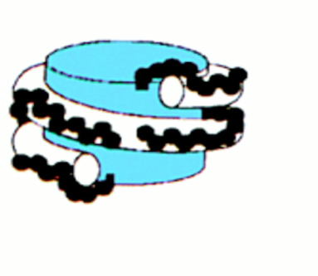

GeneICE™ platform
GeneICE™: Gene Inactivation by Chromatin Engineering
  Patents granted in Europe, US and Australia
Therapeutics and discovery platform
  GeneICE™ recruits and applies gene silencing complexes known as
  Histone Deacetylase Complexes (HDACs) to target genes
A cellular mechanism for long term gene repression
Acetylated Histone Tails
HDAC
Active gene Inactive gene
(accessible to (inaccessible)
transcription factors)

Slide 8
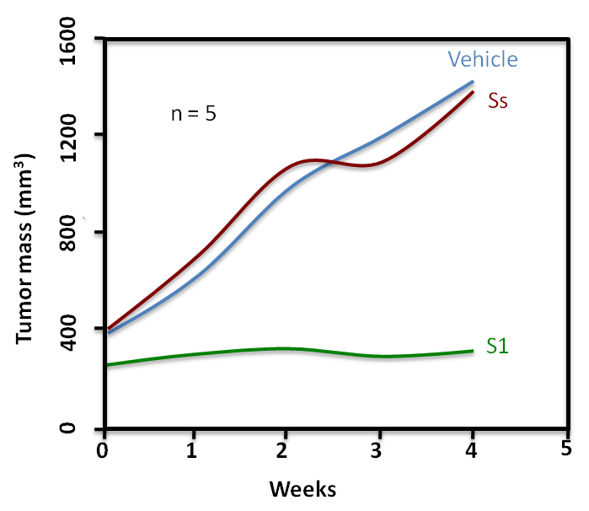
VAL201
Vali 201 peptide has shown in vivo activity
Hormone refractory and metastatic tumours
Key
Vehicle- Negative Control
Ss- Negative Control
S1- Treatment Val 201
Virtually complete repression of tumour growth in Xenograft model

Slide 9
Milestones
Achieved 2010
Progress in several areas of business
Successful completion of additional preclinical work with GeneICE therapeutics with accelerated development – Eurostar
Expansion of Self – Check kit range (OTC)
Revenue generation
VAL 201 further proof of concept
Review of business model
Restructuring of finances and reduction of cost base
www.valirx.com
9

Slide 10
Targets
Targets 2011
Accelerate pre clinical progress of Val101 and Val201
Support sales and marketing activities of Valimedix
Develop companion diagnostics for use in therapeutic programmes
Support development of HPV diagnostic testing
www.valirx.com
10

Slide 11
Thank You
Dr Satu Vainikka
satu.vainikka@valirx.com

